Slide 1

Note: The data and information in this document is reflective of a hypothetical situation and client. This document is to be used for KPMG Virtual Internship purposes only.
Sprocket Central Pty Ltd
Data analytics approach
[Division Name] - [Engagement Manager], [Senior Consultant], [Junior Consultant]

Slide 2
Note: The data and information in this document is reflective of a hypothetical situation and client. This document is to be used for KPMG Virtual Internship purposes only.
Agenda
Data Exploration
Model Development
Interpretation

Slide 3
Note: The data and information in this document is reflective of a hypothetical situation and client. This document is to be used for KPMG Virtual Internship purposes only.
Data Exploration
Step 1 : sort 100 people from the list of raw data by using RFM model , R : recency , F : frequency , M: for the money that they contribute to the companies
Step 2 : assign value and rank 100 people , Platinum , Gold , Silva , Bronze , respectively are people who contribute from the most to the least .
Step3 : from the model , run the data exploration and hypothesis testing

Slide 4
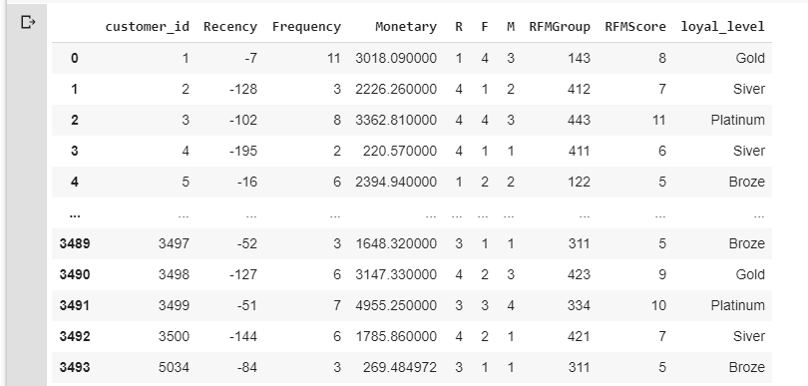

Slide 5
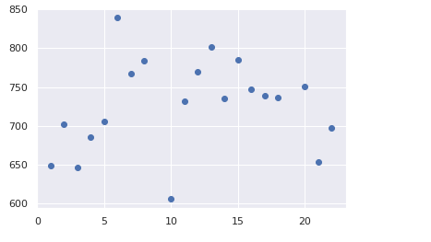
Tenure
People from the tenure 0-5 and over 20 seem, only make profits, around 700 hundred dollar, but people form the senior level 6- 15 make more than 760 dollar.

Slide 6
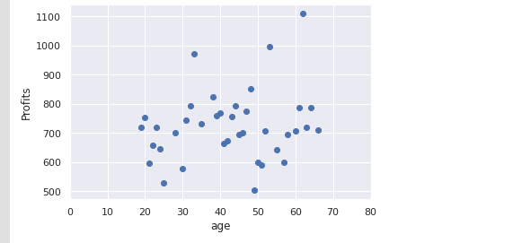
Age
In the group of 100 customers , most of people from the age 20 to 80 are likely to by with the price range from 700 – 800 dollar

Slide 7
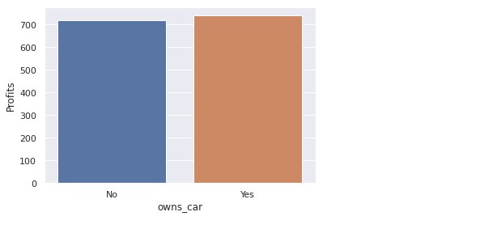
Will people who own cars affect decision in buying bicycles?
In the bar plot we can see there is a small different in the people who own more care will have the tendency to buy more car. However, it is not yet proved. Therefore, I will make a hypothesis testing to see if this chart show the significant data or not

Slide 8
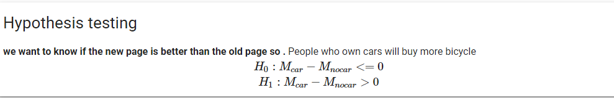
Note: The data and information in this document is reflective of a hypothetical situation and client. This document is to be used for KPMG Virtual Internship purposes only.
Model Development
Hypothesis testing to test if people who have car will buy more bicycle like the previous picture or not

Slide 9
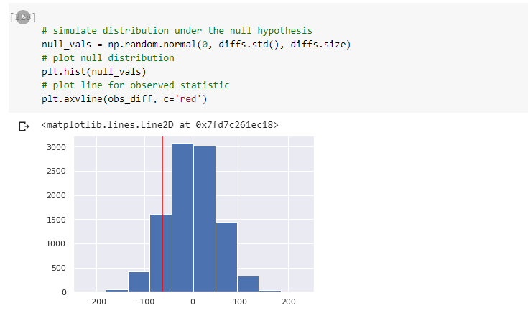
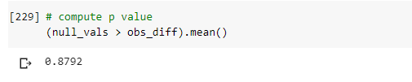
P value show that :
even in the data of each segment show people have car buy more bicycle ,
P value > 0.05 show that it can not reject the null hypothesis . So people have no car will buy more bicycle

Slide 10
Note: The data and information in this document is reflective of a hypothetical situation and client. This document is to be used for KPMG Virtual Internship purposes only.
Interpretation
Place headline insight or information here. This should be the most important point for this slide.
Place any information about this point here.
Place any supporting images, graphs, data or extra text here.

Slide 11
What additional external datasets may be useful to obtain greater insights into customer preferences and propensity to purchase the products?
More variable to conduct regression analysis of factors affect customers buying decision for example variable : distance from home to work
Data should be more than 10000 , more customers to build accurate models

Slide 12
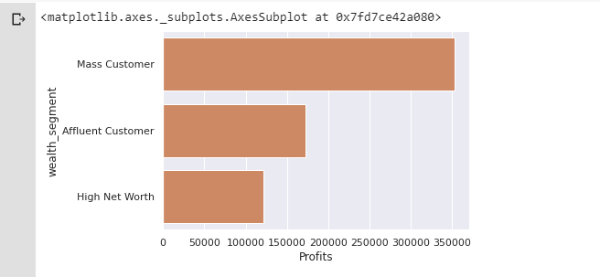
Which customer segment has the highest customer value?
Mass customers

Slide 13
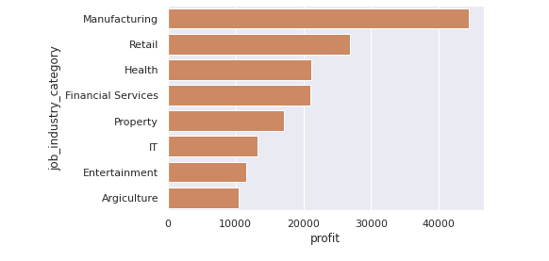
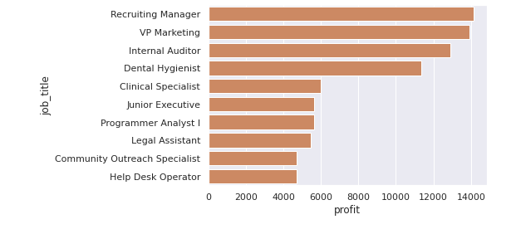
What are the trends in the underlying data?
High net worth

Slide 14
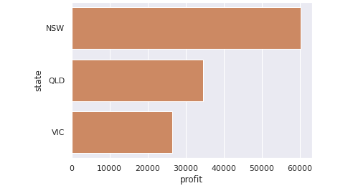
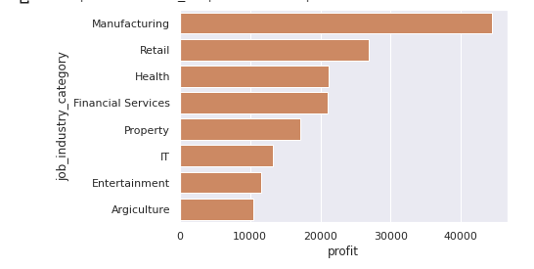
What are the trends in the underlying data?
High net worth

Slide 15
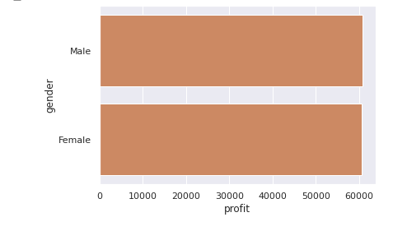
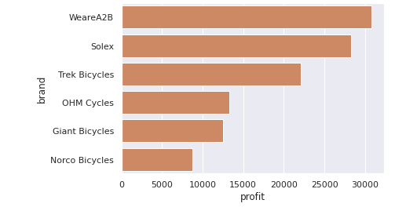
What are the trends in the underlying data?
High net worth

Slide 16
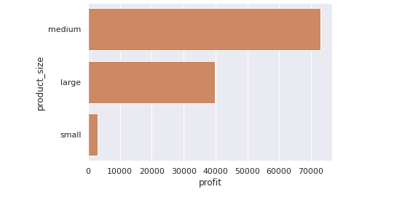
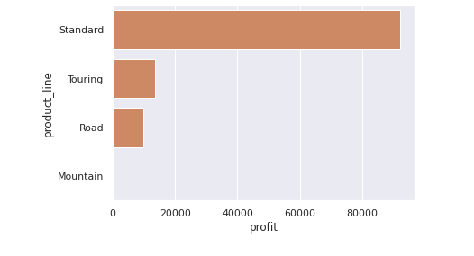
What are the trends in the underlying data?
High net worth

Slide 17
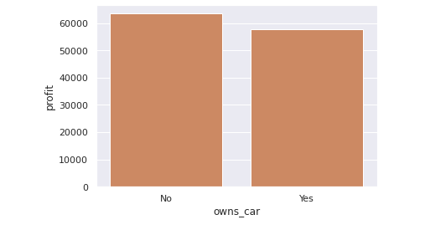
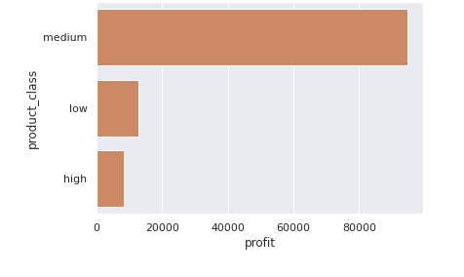
What are the trends in the underlying data?
High net worth

Slide 18
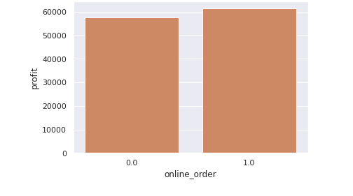
What are the trends in the underlying data?
High net worth

Slide 19
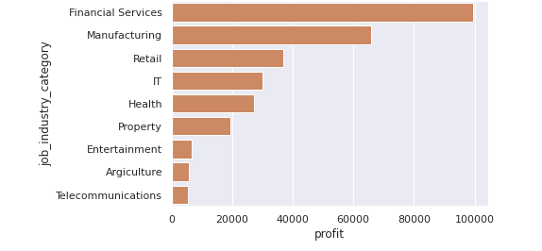
What are the trends in the underlying data?
High net worth

Slide 20
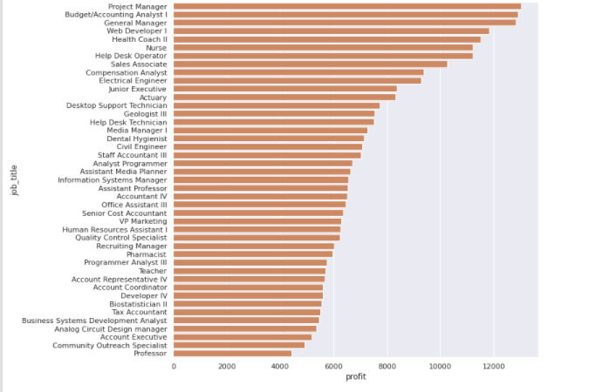
What are the trends in the underlying data?
Mass customers

Slide 21
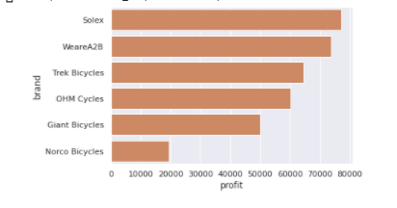
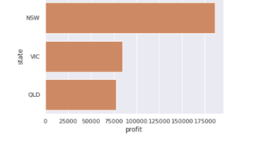
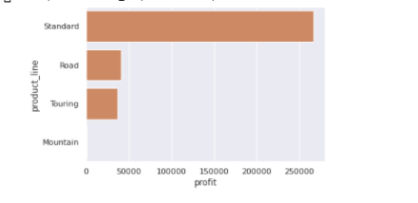
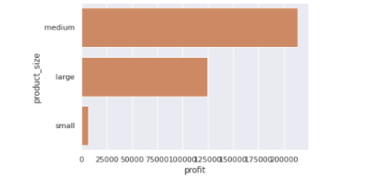
What are the trends in the underlying data?
Mass customers

Slide 22
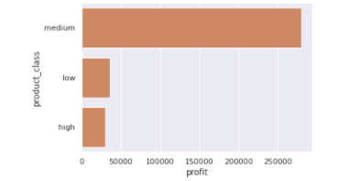
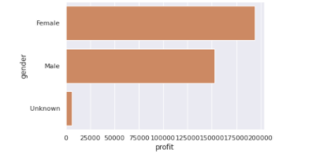
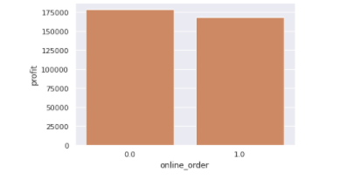
What are the trends in the underlying data?
Mass customers

Slide 23
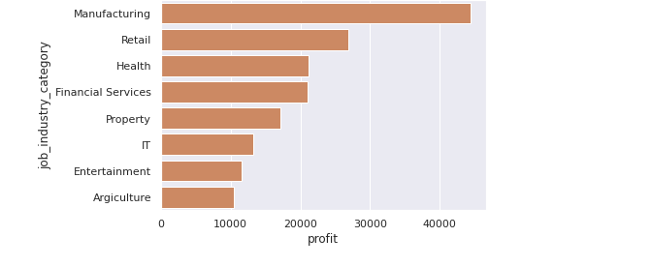
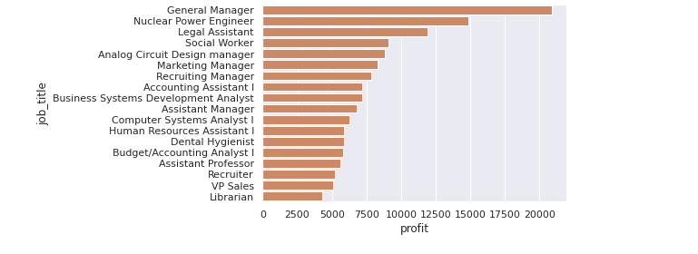
What are the trends in the underlying data?
Affluent Customers

Slide 24
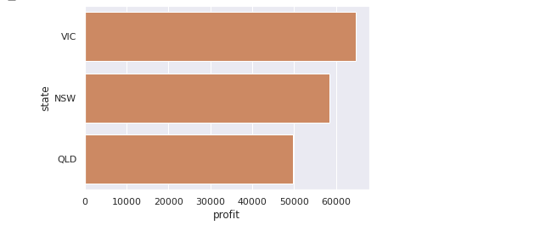
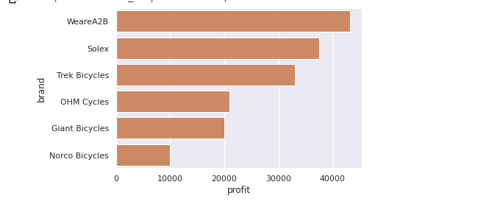
What are the trends in the underlying data?
Affluent Customers

Slide 25
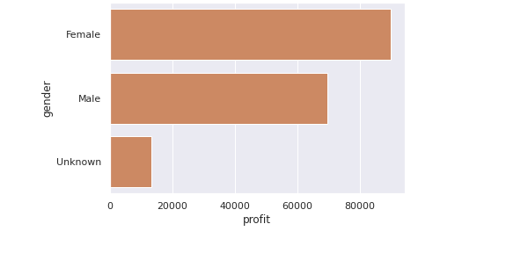
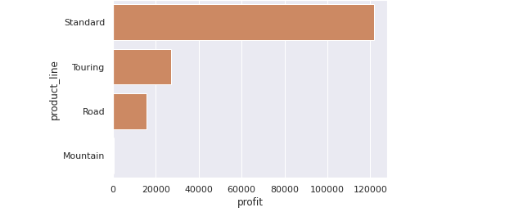
What are the trends in the underlying data?
Affluent Customers

Slide 26
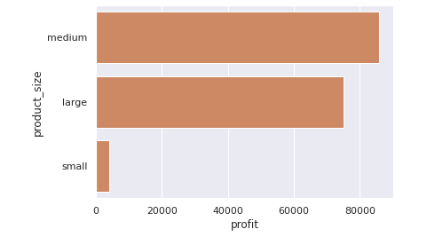
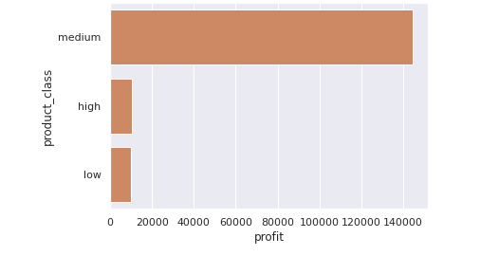
What are the trends in the underlying data?
Affluent Customers

Slide 27
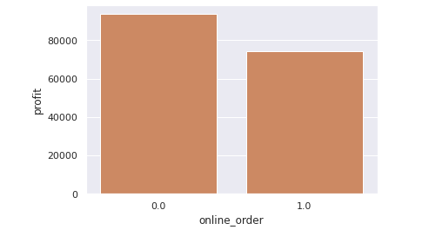
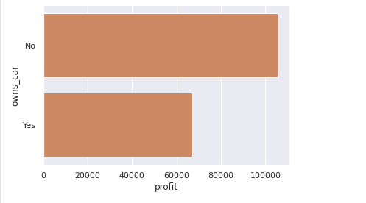
What are the trends in the underlying data?
Affluent Customers

Slide 28
What do you propose should be Sprocket Central Pty Ltd ’s marketing and growth strategy?
### Mass customers(average customers)
Even they don't pay alot for each products. However, they are they ones in total contribute the most compared to Affluent and High Net Worth customers.
The people from Mass segmentation are mostly from business level including Financial Services , Manufacturing, Retail. They are Project Manager, Analysist, manager, web developer, coach, nurse. They are from New South Wales. The products which are famous are solex and WeareA2B and medium types of bicycle. Female has more intention to buy bicycle. The special figure in this mass segment people who own cars are likely to buy more bicycle than who has no cars and people like to buy online.
=> therefore , should make a marketing strategy aim
4P
Products: Solex, WeareA2B, medium class, medium size
Place run strategy in New South West ,
2C
Customers: female, no has no cars, business jobs

Slide 29
What do you propose should be Sprocket Central Pty Ltd ’s marketing and growth strategy?
Affluent customers ( rich customers)
Affuent customers in the list of 100 customers should be retained ,most of them who contribute the most to the profits of the companies come from 1) manufacturing industry, retail , health care. So when making a marketing strategy, this companies should target to those 3 main industry. People from Victory buy more bicycle than others. WeareA2B is the bestseller, next is solex and trek bicycle, people prefer standards bike with medium and large size , touring and road account for small amount, mountain bicycle c is not significant. median class are more sought-after .This this affluent section , female is more dominant compared to Male customers=> Therefore , should customize more option for woman. Most people who buy cars don't have cars. People prefer to buy cars on the spots.
4P
Place: Victory
Products: WeareA2B,solex, trekbicycle , standard bike , large size, medium size, touring and road bike
2C
Customers : manufactures, and health cares , female

Slide 30
What do you propose should be Sprocket Central Pty Ltd ’s marketing and growth strategy?
## High Net Worth (a rich person who has at least $1 million available to make investments with)
The highest ranking of job industry category segment is Health. The people in this segment who buy bicycle the most seems really care about health because customers who came from health segment is 2.6 times than the 2nd one. Who live mostly in New South Wales (NSW) state.
The bicycle WeareA2B is till the best seller in this segment. Product size, product class and product line are mostly profitable in standard and medium bicycles . There is no difference between male and female purchase in High Net Worth. In contrary with affluent customers, the online order is slightly higher than offline, and the ratio of own cars is not so different.
4P
Place: New South Wales
Products: WeareA2B, standard bike , medium size,
2C
Customers : health cares, both genders

